Slide 1



Advanced machine learning
Presented by: Chandana MN
Rupa Shravya
Rakshita
Divyashree
Akshita
Keshav

Slide 2
Semi-supervised learning

Slide 3

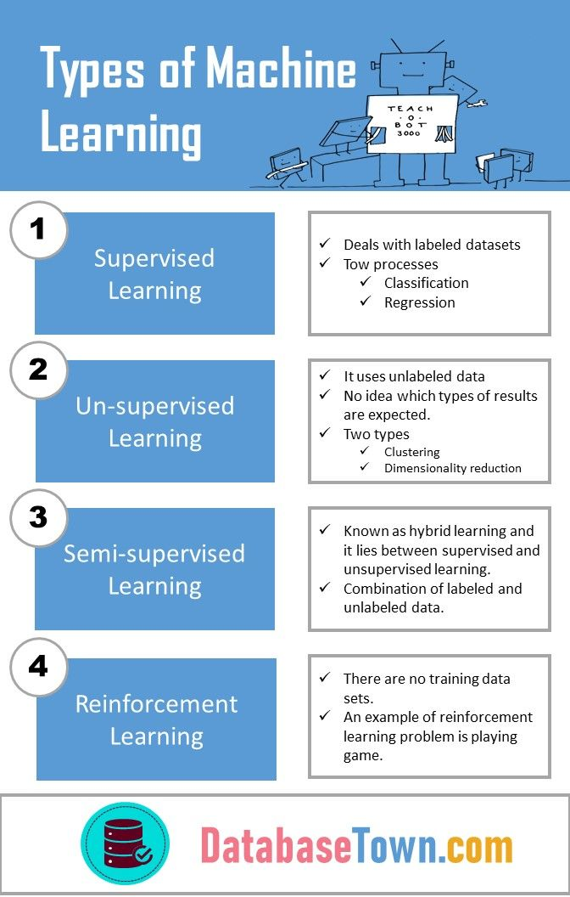

Slide 4
Semi-supervised learning
Semi-supervised learning is an approach to machine learning that combines a small amount of labeled data with a large amount of unlabeled data during training.
Semi-supervised learning falls between unsupervised learning (with no labeled training data) and supervised learning (with only labeled training data). It is a special instance of weak supervision.

Slide 5
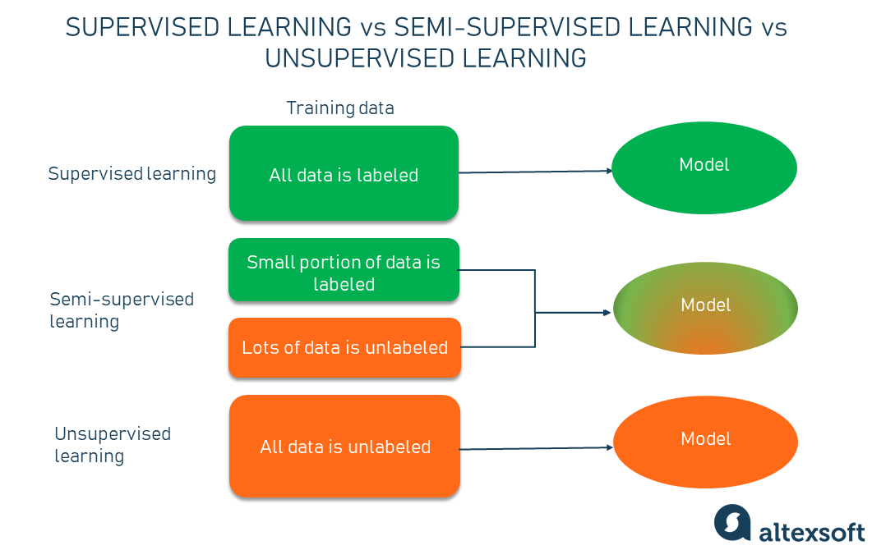

Semi-supervised learning bridges supervised learning and unsupervised learning techniques to solve their key challenges. With it, train an initial model on a few labeled samples and then iteratively apply it to the greater number of unlabeled data.
Unlike unsupervised learning, SSL works for a variety of problems from classification and regression to clustering and association.
Unlike supervised learning, the method uses small amounts of labeled data and large amounts of unlabeled data, which reduces expenses on manual annotation and cuts data preparation time.

Slide 6
How semi-supervised learning works
Imagine, having collected a large set of unlabeled data on which you want to train a model.
Manual labeling of all this information will probably cost a fortune, besides taking months to complete the annotations. That’s when the semi-supervised machine learning method comes to the rescue.
The working principle is quite simple. Instead of adding tags to the entire dataset, we go through and hand-label just a small part of the data and use it to train a model, which then is applied to the ocean of unlabeled data.

Slide 7
examples of semi-supervised learning methods
Self-training
Co-training
SSL with graph-based label propagation

Slide 8
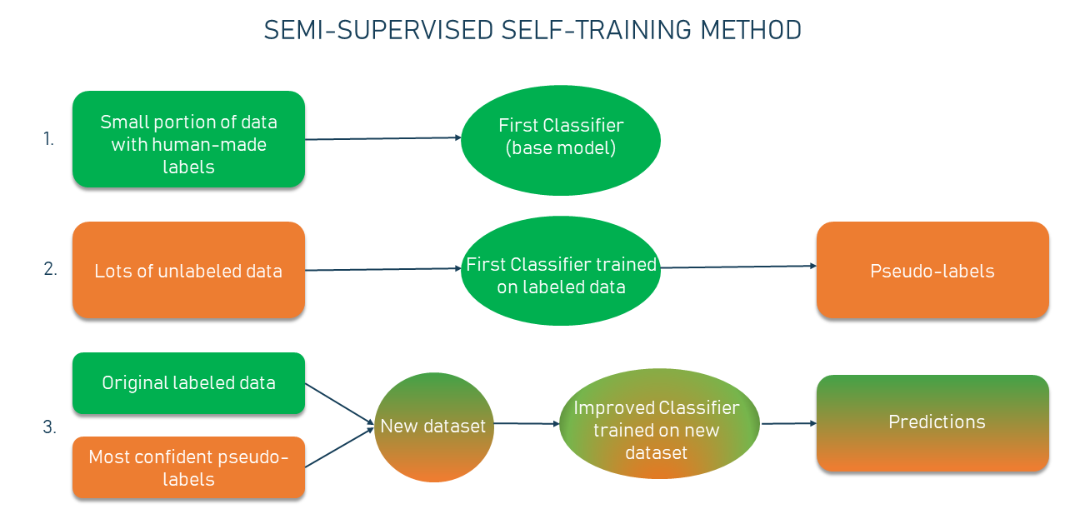
Self-training
One of the simplest examples of semi-supervised learning, in general, is self-training.
Self-training is the procedure in which you can take any supervised method for classification or regression and modify it to work in a semi-supervised manner, taking advantage of labeled and unlabeled data.

Slide 9
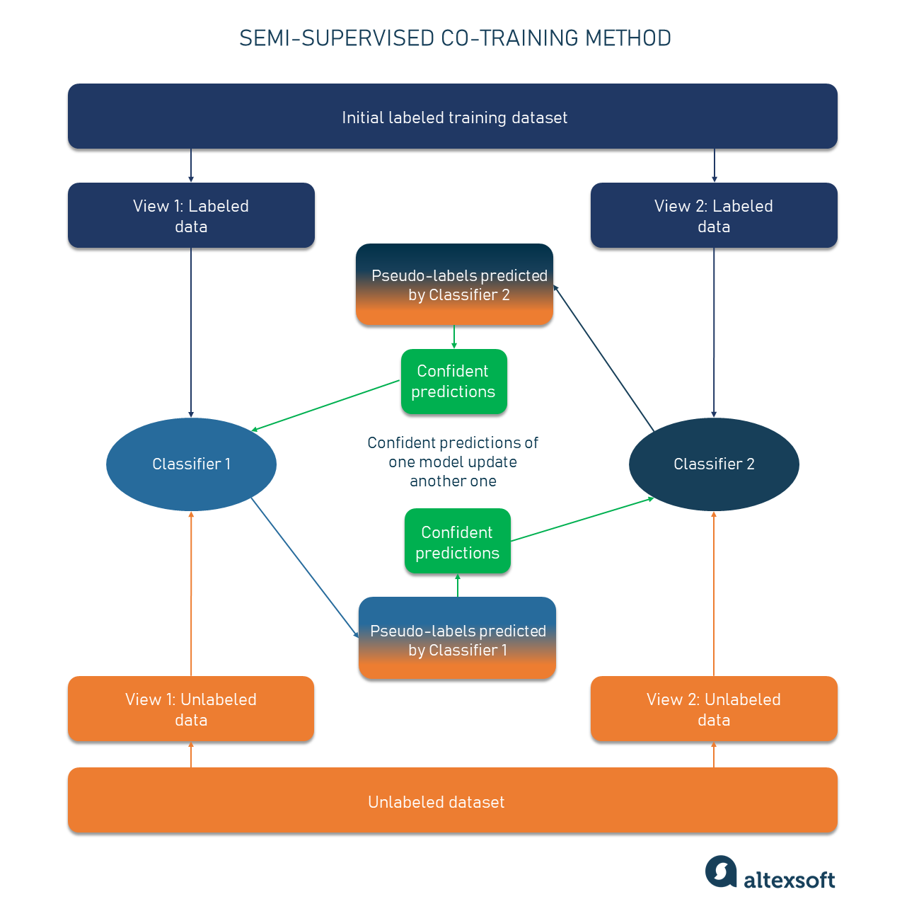
Co-training
co-training is another semi-supervised learning technique used when only a small portion of labeled data is available. Unlike the typical process, co-training trains two individual classifiers based on two views of data.
The views are basically different sets of features that provide additional information about each instance, meaning they are independent given the class. Also, each view is sufficient — the class of sample data can be accurately predicted from each set of features alone.
for example, for web content classification tasks. The description of each web page can be divided into two views: one with words occurring on that page and the other with anchor words in the link leading to it.

Slide 10
Semi-supervised learning examples
Speech recognition
Labeling audio is a very resource- and time-intensive task, so semi-supervised learning can be used to overcome the challenges and provide better performance.
Facebook (now Meta) has successfully applied semi-supervised learning (namely the self-training method) to its speech recognition models and improved them.
They started off with the base model that was trained with 100 hours of human-annotated audio data. Then 500 hours of unlabeled speech data was added, and self-training was used to increase the performance of the models.
As far as the results, the word error rate (WER) decreased by 33.9 percent, which is a significant improvement.

Slide 11
Web content classification
With billions of websites presenting all sorts of content out there, classification would take a huge team of human resources to organize information on web pages by adding corresponding labels.
The variations of semi-supervised learning are used to annotate web content and classify it accordingly to improve user experience.
Many search engines, including Google, apply SSL to their ranking component to better understand human language and the relevance of candidate search results to queries.
With SSL, Google Search finds content that is most relevant to a particular user query.

Slide 12
Text document classification
Another example of when semi-supervised learning can be used successfully is in the building of a text document classifier. Here, the method is effective because it is difficult for human annotators to read through multiple word-heavy texts to assign a basic label, like a type or genre.
For example, a classifier can be built on top of deep learning neural networks like LSTM (long short-term memory) networks that can find long-term dependencies in data and retrain past information over time. Usually, training a neural net requires lots of data with and without labels. A semi-supervised learning framework works just fine as you can train a base LSTM model on a few text examples with hand-labeled most relevant words and then apply it to a bigger number of unlabeled samples.

Slide 13
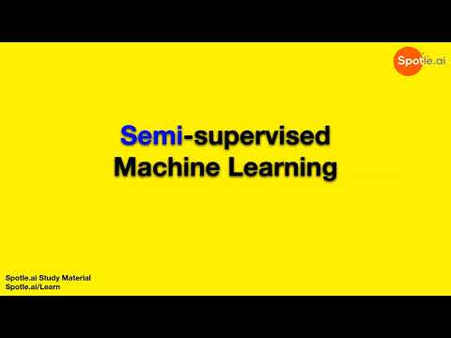
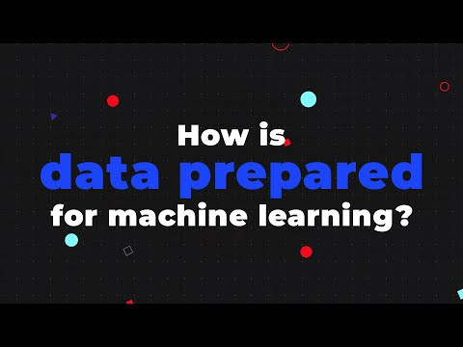
https://www.youtube.com/watch?v=g5y9dwXRprg https://www.youtube.com/watch?v=P8ERBy91Y90&t=5s

Slide 14


